Slide 1

Serverless Computing: A New Paradigm in Cloud & OS
Serverless computing represents a radical shift in how applications are built and deployed. It abstracts away the complexities of server management, allowing developers to focus solely on writing code. This approach promises to revolutionize modern computing, offering unparalleled scalability, cost-efficiency, and operational simplicity.
By:
Sarthak Chavan
Harshwardhan Chinchkhedkar
Yash Chikhale
Kunal Ailsinghani

Slide 2
Table of Contents
In this presentation, we'll embark on a comprehensive journey through the world of serverless computing. We will start by defining what exactly is serverless computing and how it contrasts with traditional approaches. We'll trace its evolution, examine its architecture, and delve into the underlying operating system concepts that make it possible.
Agenda
Introduction to Serverless
Real-World Use Cases
How serverless works
Case Study: AWS Lambda in Netflix
Evolution of serverless
Future Trends
Serverless vs Traditional Computing
Serverless and the future of OS
Benefits and Challenges
Conclusion
Security Considerations
References & QNA

Slide 3

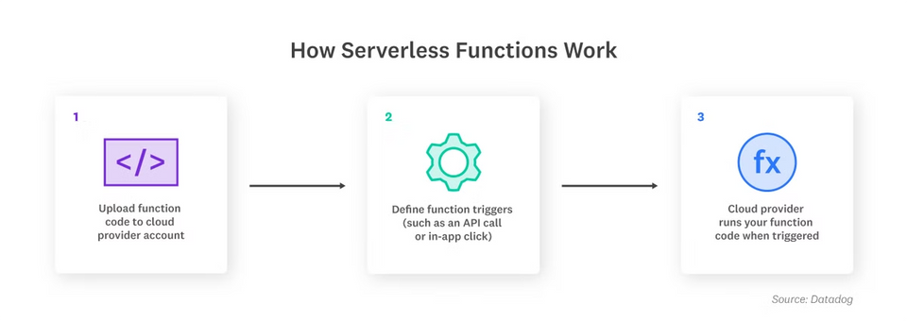




Introduction to Serverless Computing
Serverless computing is a cloud execution model where developers run code without provisioning, scaling, or managing servers. The cloud provider automatically handles the infrastructure, scaling, and execution
Misconception:
Serverless doesn’t mean there are no servers! – The servers exist, but their management is abstracted away from developers.
Key Characteristics:
No server management
Auto scaling
Cloud handles infra
Scale based on demand
Pay per use
Event-Driven Execution
Pay for execution time
Functions run only when triggered

Slide 4

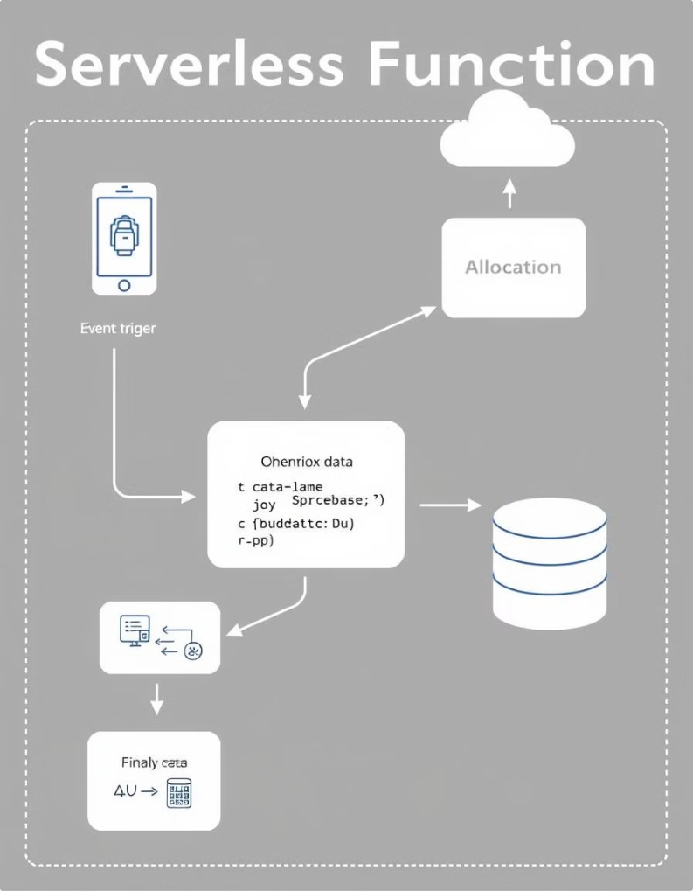




Unveiling the Inner Workings of Serverless
Serverless computing leverages Function-as-a-Service (FaaS), where small, stateless functions are executed in response to events such as HTTP requests, database updates, or file uploads. The cloud provider dynamically allocates compute resources, managing scaling, fault tolerance, and monitoring.
This abstraction empowers developers to focus on code logic rather than infrastructure management. It is important to remember that the cloud provider is responsible for managing every aspect of the underlying system.
Event Trigger
Starts function execution
Resource Allocation
Cloud provider assigns resources
Function Execution
Processes and sends output

Slide 5




The Rise of Serverless: An Evolutionary Perspective
The journey to serverless computing has been a gradual progression. It started with monolithic applications, which gave way to virtual machines (VMs), offering better resource utilization and isolation. Containers further improved efficiency and portability, paving the way for serverless computing.
Significant milestones include the introduction of AWS Lambda in 2014, followed by Google Cloud Functions and Azure Functions in 2016. Today, serverless is widely adopted in web applications, automation, and real-time data processing.
Monolithic Apps
Virtual Machines
Containers
Serverless

Slide 6
Serverless vs. Traditional Computing: A Head-to-Head Comparison
Serverless and traditional computing models differ significantly in terms of scaling, cost, maintenance, security, and performance. Traditional models (VMs/Containers) require manual or auto-scaling configurations and charge for uptime. Serverless offers fully automatic scaling and pay-per-execution pricing.
Developers manage maintenance in traditional models, while the cloud provider handles it in serverless. Security is managed by the OS in traditional setups, while the cloud provider controls isolation in serverless environments. Performance can be consistent in traditional setups, but serverless may experience variable performance due to cold starts.
Aspect
Traditional (VMs/Containers)
Serverless (FaaS)
Scaling
Manual or auto-scaling
Fully automatic
Cost
Pay for uptime
Pay per execution
Maintenance
Managed by developers
Handled by cloud provider
Security
Managed by OS
Cloud provider controls isolation
Performance
Consistent
Variable (cold start issues)

Slide 7
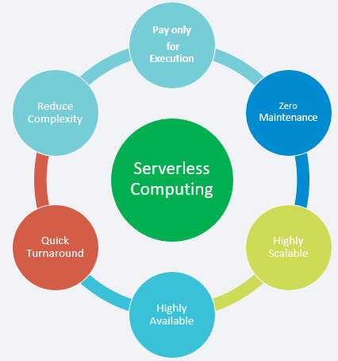




The Myriad Benefits of Serverless Computing
Serverless computing offers numerous benefits: Developers can focus on code, not infrastructure, leading to increased productivity. Auto-scaling ensures applications can handle varying workloads without manual intervention. Cost efficiency is achieved through pay-per-execution pricing.
High availability and fault tolerance are managed by the cloud provider, reducing operational overhead. Faster deployment is possible due to the absence of provisioning delays. Serverless computing leads to greater efficiency and agility.
No Server Management
Auto-Scaling
Cost Efficiency
Faster Deployment

Slide 8

Operating System Concepts in Serverless
Serverless computing relies heavily on OS concepts. Functions execute as short-lived, isolated processes with dynamic resource allocation and scaling. Virtualization and isolation are achieved through technologies like Firecracker microVMs (AWS Lambda) and gVisor (Google Cloud) for sandboxing.
Due to the stateless nature of functions, external storage solutions like AWS S3, DynamoDB, or Firebase are required for memory and storage management. Understanding these OS concepts is crucial for optimizing serverless applications.
Process Management
Resource Allocation
Virtualization
Short lived, isolated
Dynamic scaling
MicroVMs and sandboxing

Slide 9



Navigating the Challenges and Limitations of Serverless
Despite its advantages, serverless computing also presents challenges: Cold starts can cause delays when invoking an idle function. Execution limits, such as AWS Lambda's 15-minute maximum, can restrict certain workloads. Debugging complexity arises from the lack of direct access to server logs.
Vendor lock-in can make it difficult to migrate across cloud providers, and state management issues necessitate external data storage due to stateless execution. Careful consideration of these limitations is crucial for successful serverless adoption.
Cold starts
Execution Limits
Vendor lock-in

Slide 10

Security in Serverless computing
Multi-Tenancy Risks – Functions share infrastructure.
Sandboxing for Isolation – Firecracker, gVisor prevent cross-function attacks.
Common Security Risks:
Privilege escalation.
Data leakage.
Insecure dependencies.

Slide 11

Security Best Practices
Multi-Tenancy Risks
Sandboxing
Functions share infrastructure.
Firecracker, gVisor.
Least Privilege
Secure Api Gateways
Access policies.

Slide 12
Case Study: Netflix & AWS Lambda
Problem:
1
Netflix needed a scalable backend to process billions of streaming logs.
Solution
2
Used AWS Lambda for real-time data processing.
Automated scaling & fault tolerance.
Results
Lower costs due to pay-per-use model.
3
Faster response times and improved performance.
Reduced infrastructure complexity.

Slide 13
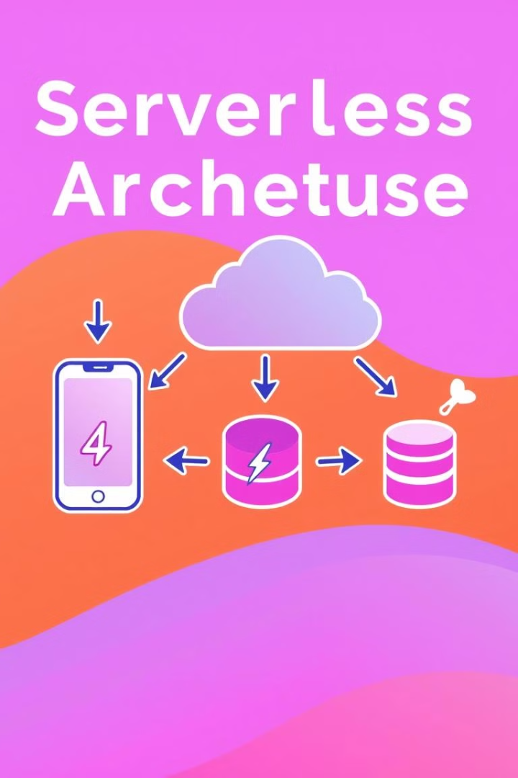




Serverless Use Cases
Web Backends
IoT Event Processing
Firebase Functions.
AWS Lambda.
Machine Learning
Data Processing & ETL
Google Cloud Functions.
AWS glue for serverless ETL workflow

Slide 14





Future Trends in Serverless
Stateful Serverless
AWS Step Functions, Durable Objects (Cloudflare)
Cold Start Optimization
SnapStart, Edge Computing.
Hybrid & Multi-Cloud
Avoiding vendor lock-in.
Serverless AI
Running AI models at the edge.

Slide 15


Conclusion
As OS architectures evolve, serverless will become more efficient, reducing cold start issues, improving stateful execution, and integrating with AI & edge computing. The next generation of computing will be more event-driven, serverless, and highly optimized for performance & cost.
Why Serverless Matters?
Eliminates server provisioning & maintenance.
Enables efficient resource utilization & auto-scaling.
Reduces costs with pay-per-use billing.
Powers real-time applications, automation, and AI-driven workloads.

Slide 16
References
Netflix's serverless Case Study : https://medium.com/@pradeepkr848115/serverless-technology-in-aws-a-netflix-case-study-6df6ca5bd241
Serverless Computing: Current Trends and Open Problems : https://www.researchgate.net/publication/322092289_Serverless_Computing_Current_Trends_and_Open_Problems

